Slide 1
We will be recognizing the differences between minerals and rocks
TRACK WITH ME
READ WITH ME
I can describe differences between rocks and minerals
I can name different properties of minerals

Slide 2

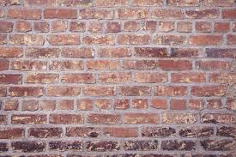
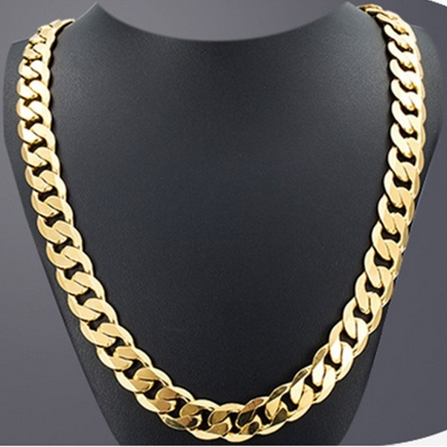
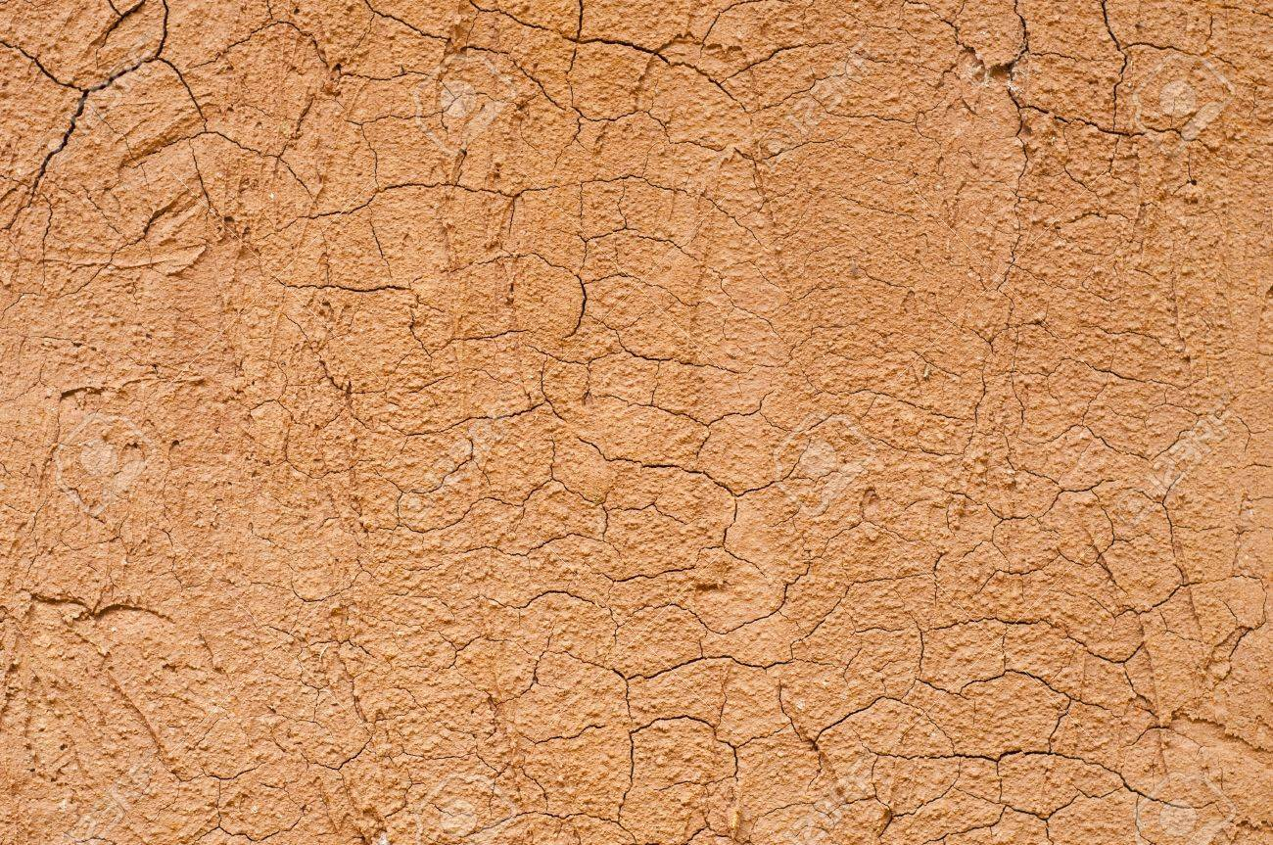
SWBAT describe characteristics of minerals that make them different to rocks
What do all these images have in common?

Slide 3
HINT
Composition- What it is made up of
We will be recognizing the differences between minerals and rocks
Minerals vs rocks
A mineral is a naturally occurring element or compound that has the same composition throughout.
A rock is a substance made up of one or more minerals.

Slide 4
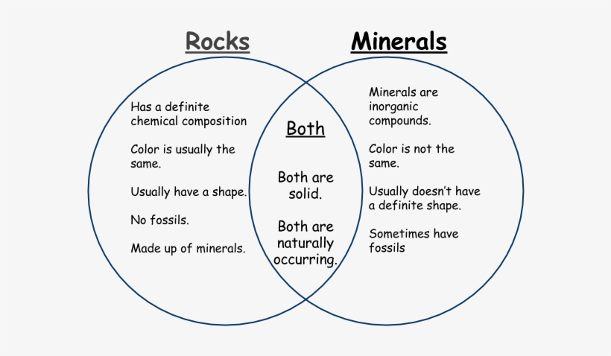
We will be recognizing the differences between minerals and rocks

Slide 5
We will be recognizing the differences between minerals and rocks
The first step in determining whether it is a rock or mineral is whether it is the same composition throughout

Slide 6
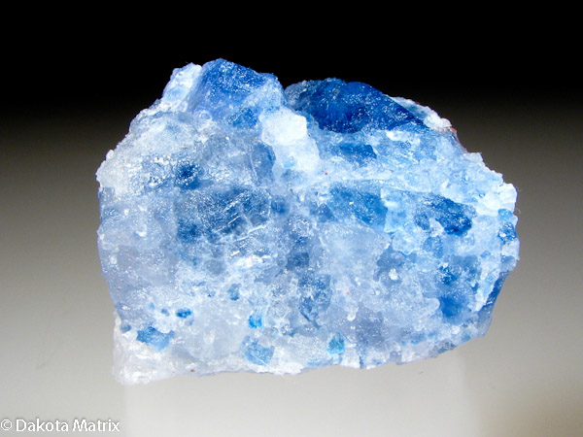
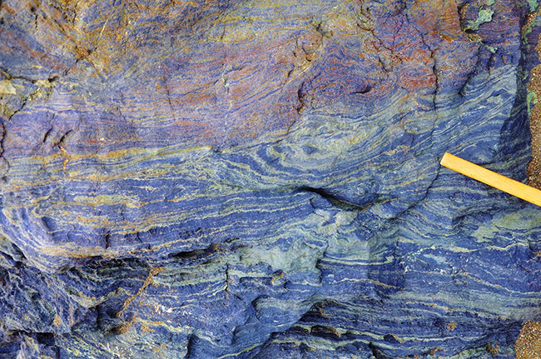
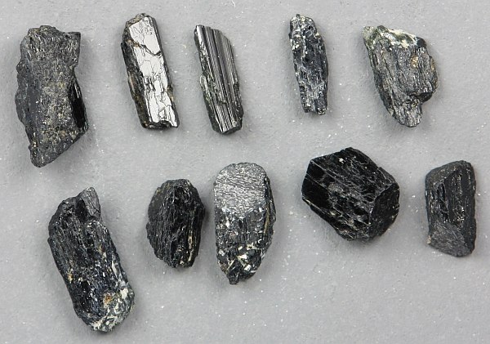
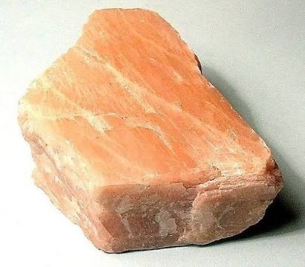
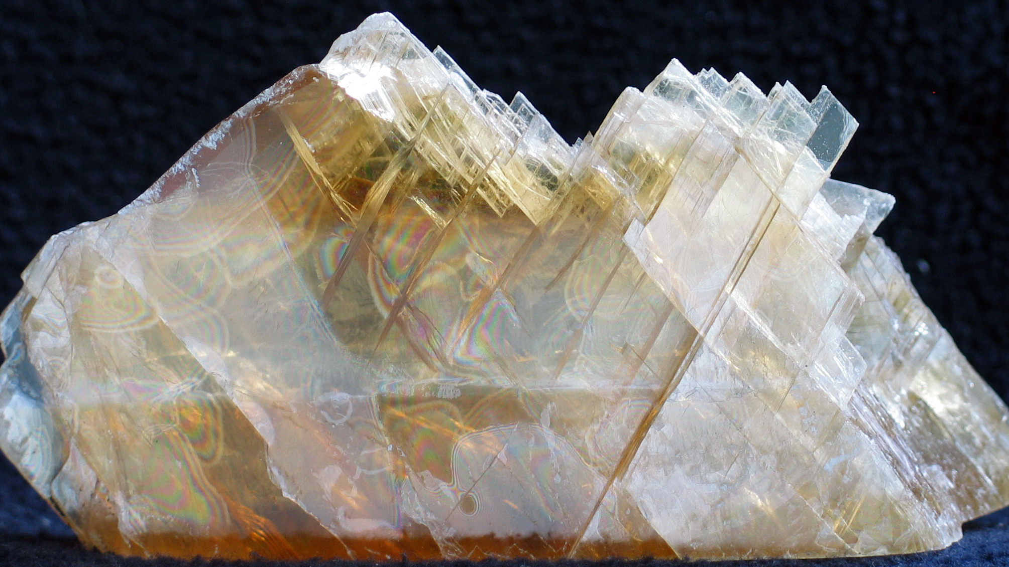
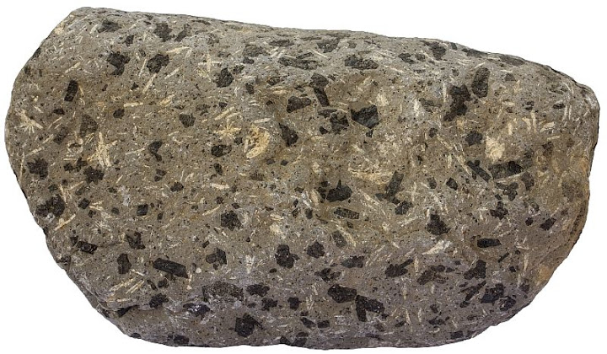
We will be recognizing the differences between minerals and rocks
ROCK OR MINERAL?

Slide 7
We will be recognizing the differences between minerals and rocks
Minerals
Minerals have a fixed shape and volume. They also have a crystal structure and the same chemical composition.

Slide 8
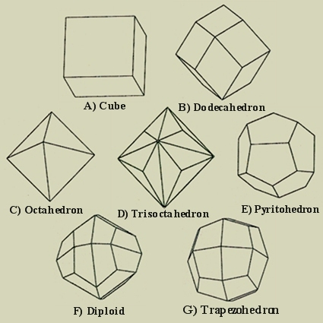
We will be recognizing the differences between minerals and rocks
What does a crystal structure mean?
The particles line up in regular repeating patterns
The flat sides are called faces, that meet at sharp edges and corners.

Slide 9
We will be recognizing the differences between minerals and rocks
What are some of the properties of minerals?
Hardness
Density
Lustre
Streak
Colour
Cleavage

Slide 10
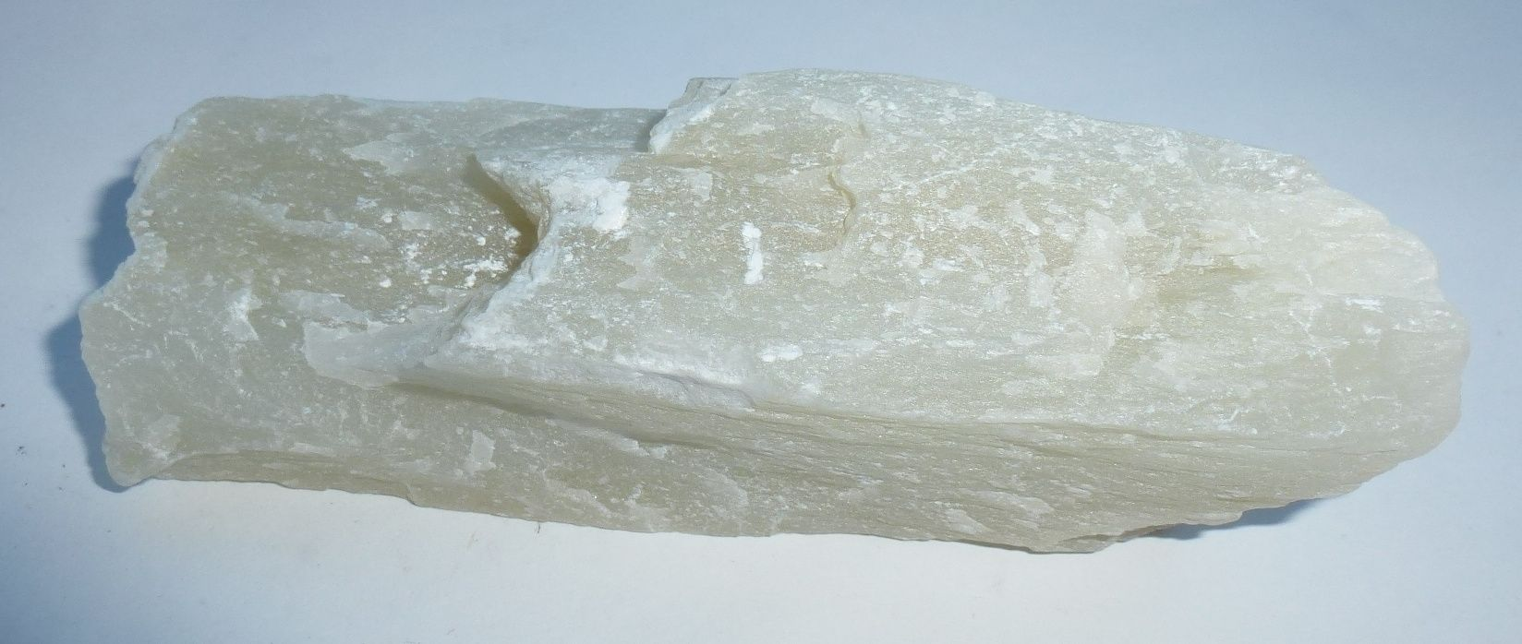
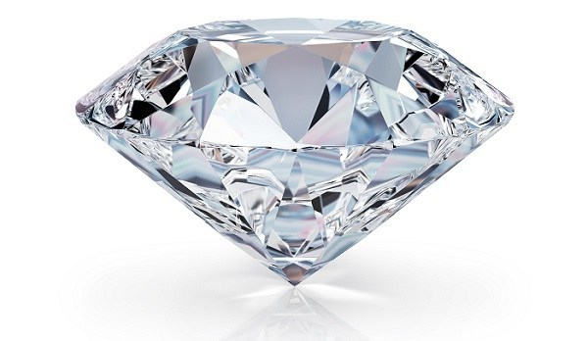
We will be recognizing the differences between minerals and rocks
Properties of minerals- hardness
The hardness of minerals is a measure of how easily something can be scratched.
Some minerals can be very hard like diamond and other minerals can be soft like talc.

Slide 11
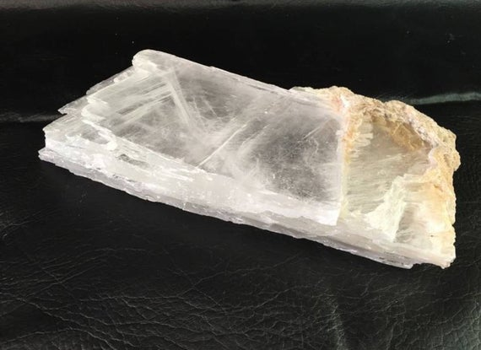
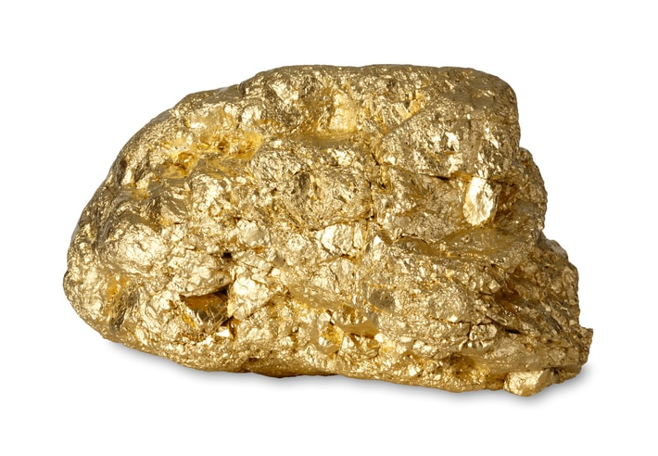
We will be recognizing the differences between minerals and rocks
Properties of minerals- density
The density if the amount of mass per unit of volume.
Basically, it is how heavy a material is for its size.
Every mineral has a specific density regardless of how large it is.
High density mineral
Gold
Low density mineral
Gypsum

Slide 12
We will be recognizing the differences between minerals and rocks
Properties of minerals- Lustre
The lustre is the way a material reflects light. This can be:
Metallic
Dull
Waxy
Pearly
Glassy

Slide 13
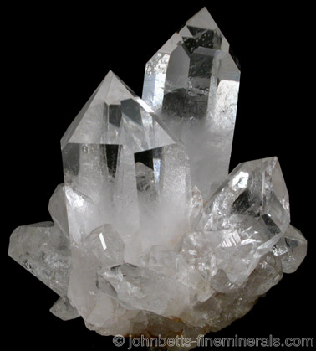
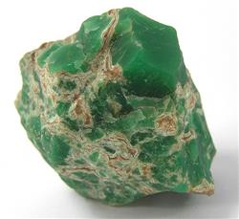
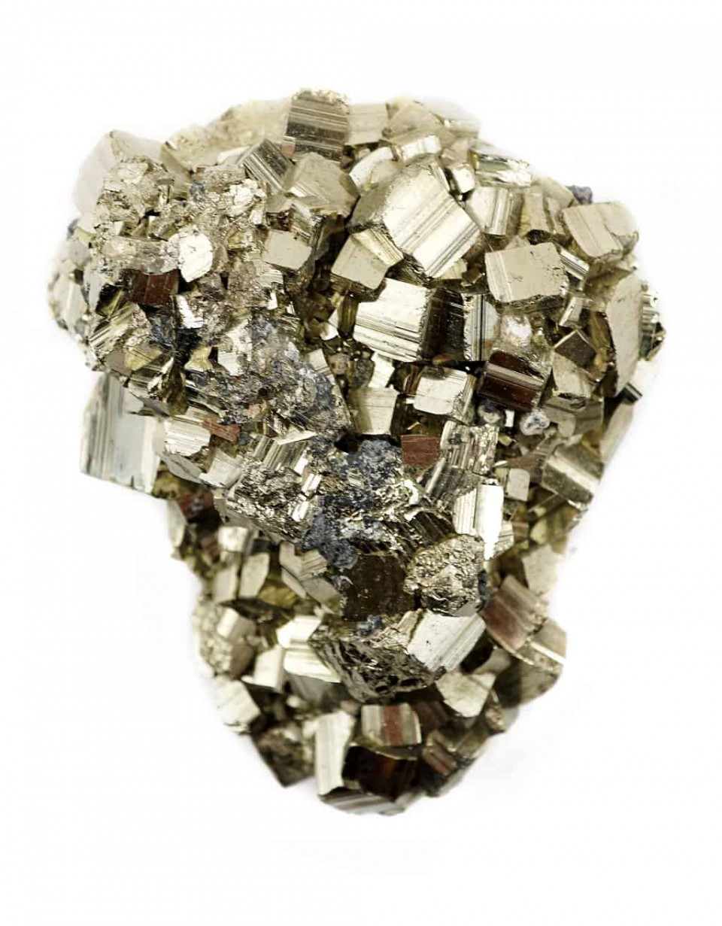
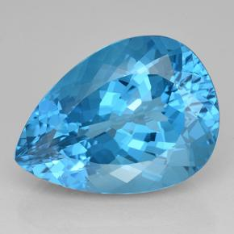
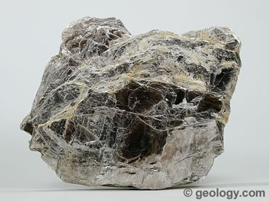
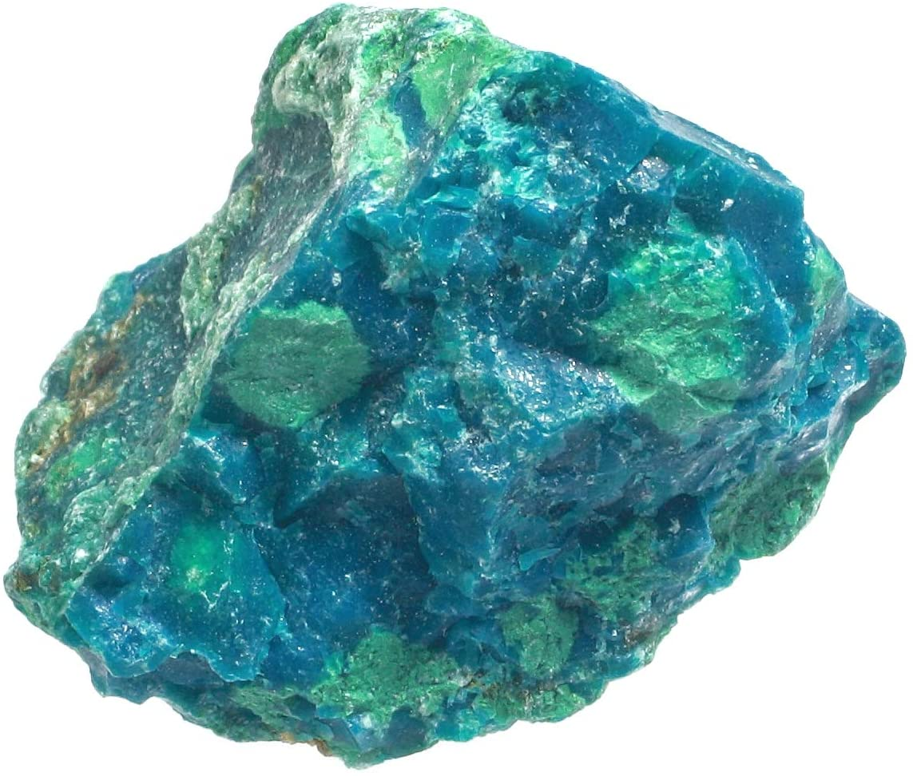
We will be recognizing the differences between minerals and rocks
Which lustre would you use to describe these minerals?
Pyrite (fools gold)
Variscite
quartz
Muscovite
Chrysocalla
Topaz
Notes:
Get out of seat to encourage and use as brain break
Metallic
Waxy
Glassy
Pearly
Dull
Glassy

Slide 14
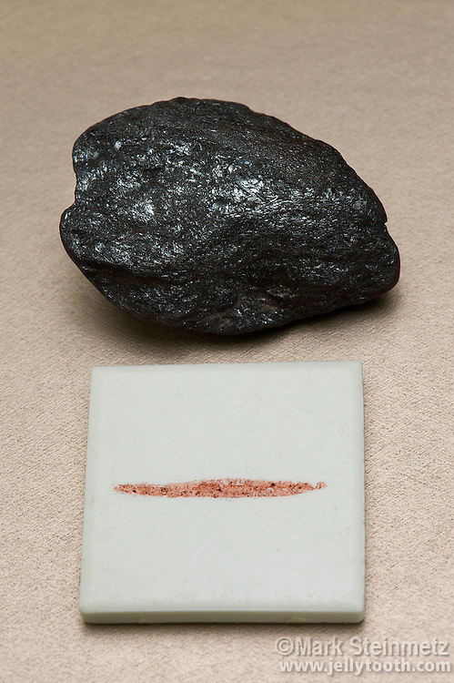
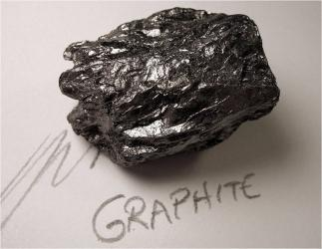
We will be recognizing the differences between minerals and rocks
Properties of minerals- Streak
The streak of a mineral is the colour of the powder as it is scratched on the surface.
Graphite is one of our most common used streaks. Can you explain why?
Hematite

Slide 15
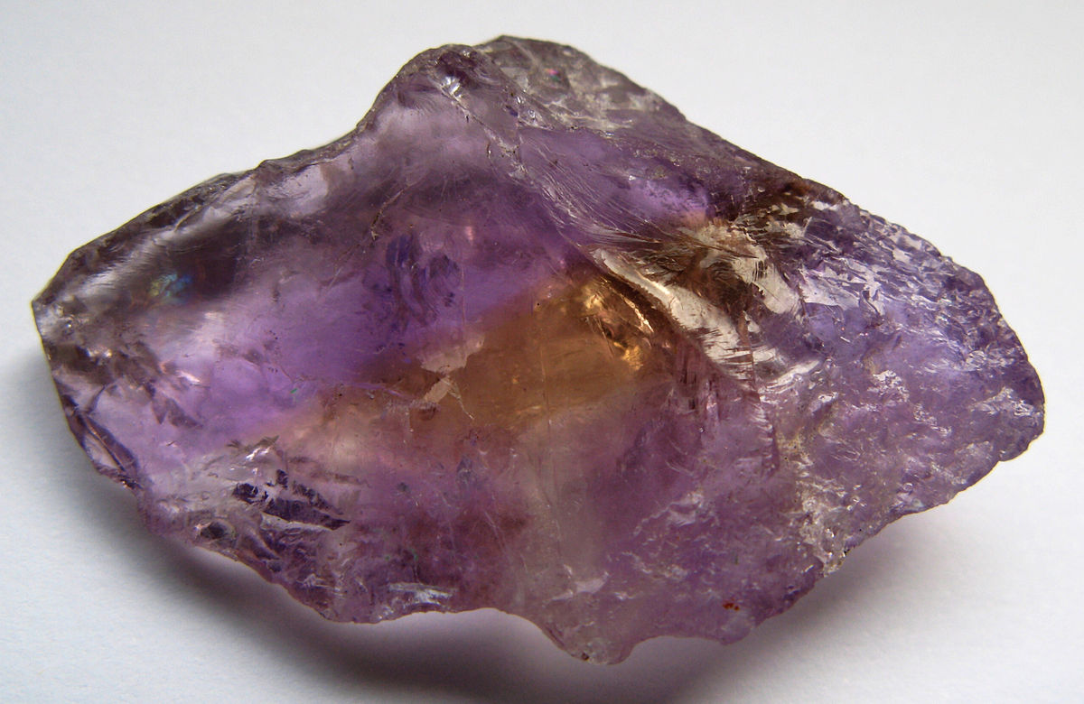
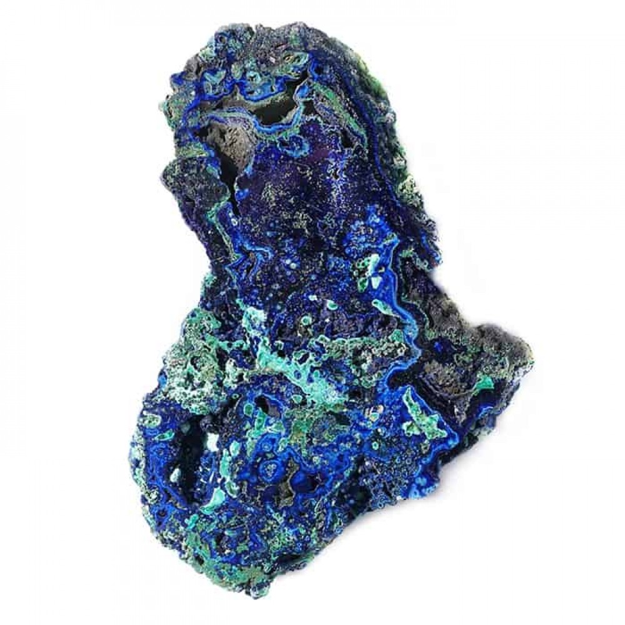
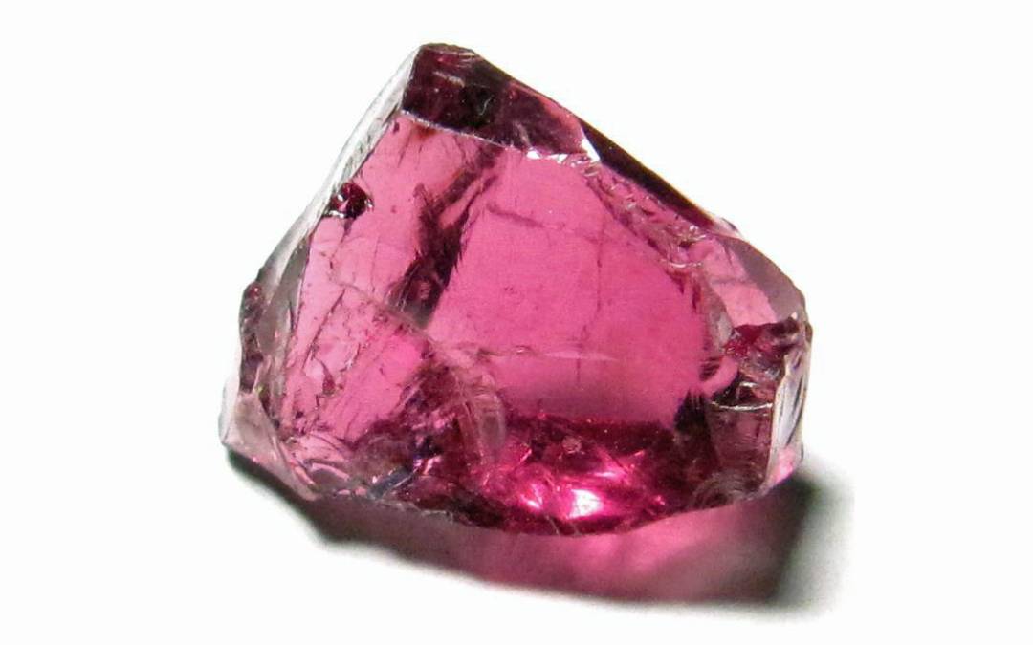
We will be recognizing the differences between minerals and rocks
Properties of minerals- colour
Another property of minerals are bright colours, that are often present throughout.
Ametrine
Garnet
Azurite

Slide 16
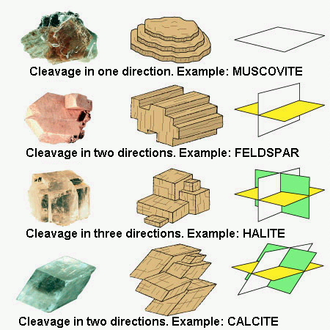
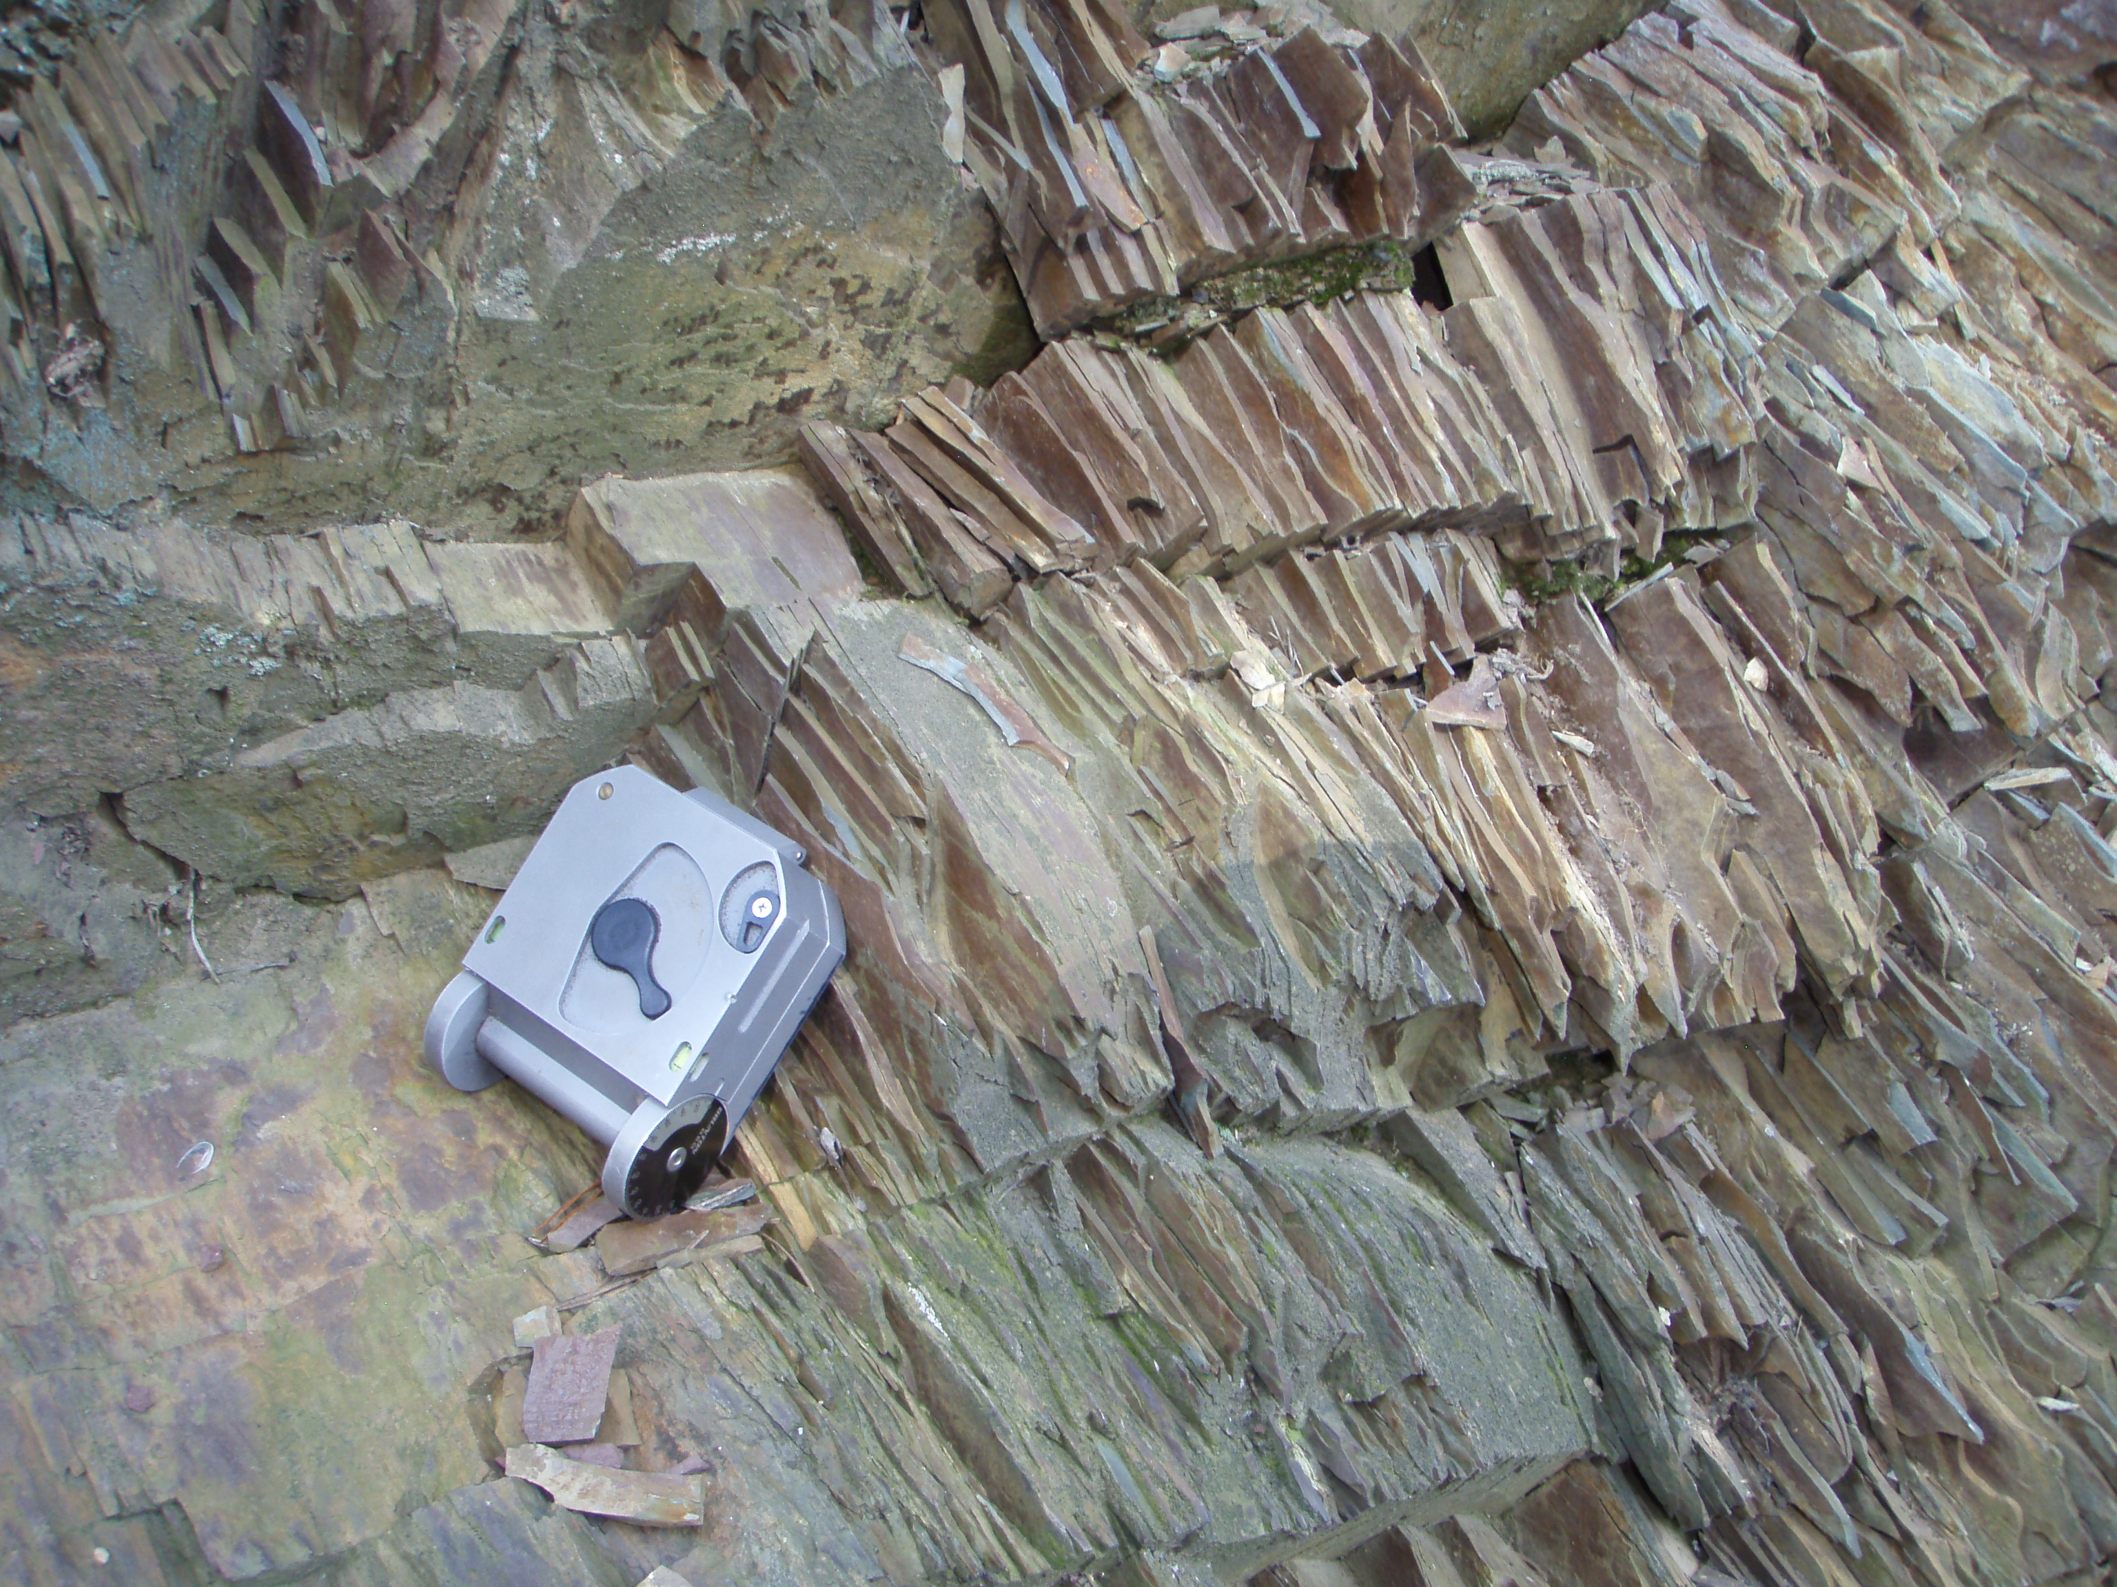
We will be recognizing the differences between minerals and rocks
Properties of mineral- Cleavage
Cleavage is the tendency for a rock to break along the surface

Slide 17
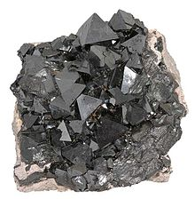
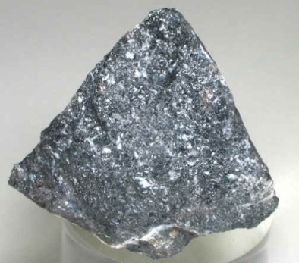
We will be recognizing the differences between minerals and rocks
Properties of minerals- magnetism
Some minerals have magnetic properties that are caused by the minerals, and the orientation of the Earth’s magnetic field at the time of formation.
Magnetite
Chromite

Slide 18
List the minerals have similar colours
List the minerals that leave a streak
List the minerals that have the same lustre and what that is
List the minerals that are very dense
List the minerals that are not very dense
List the minerals that have cleavage in one direction

Slide 19
We will be recognizing the differences between minerals and rocks
TRACK WITH ME
READ WITH ME
I can describe differences between rocks and minerals
I can name different properties of minerals

